Slide 1
Our school – Vinica Primary school
made by the whole group

Slide 2
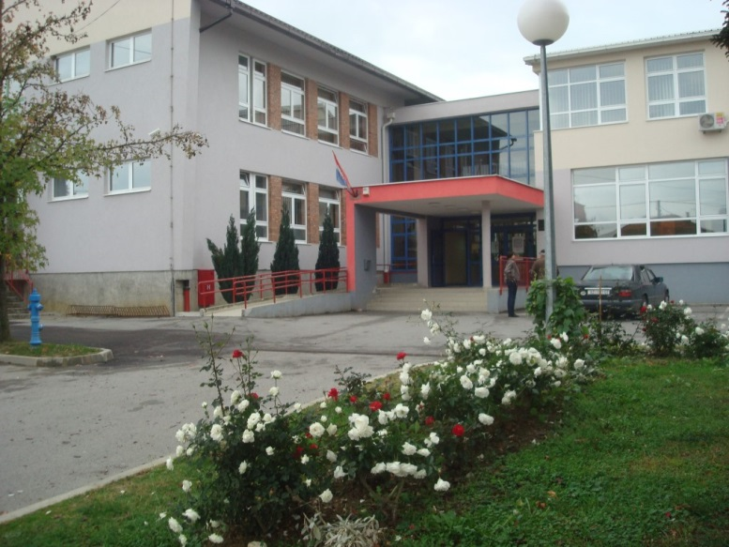
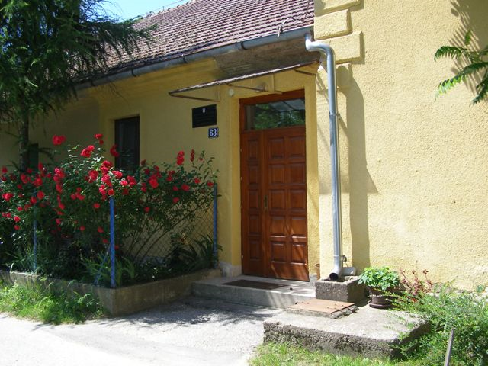
About school
Our school is in a little
village called Marčan/m^rʧ^n/.
There are 275 students and
31 teachers.
School has 2 more local schools and together they have 40 students.
In every school there are 2 teachers and 1 chef.
One of the 2 local schools.

Slide 3
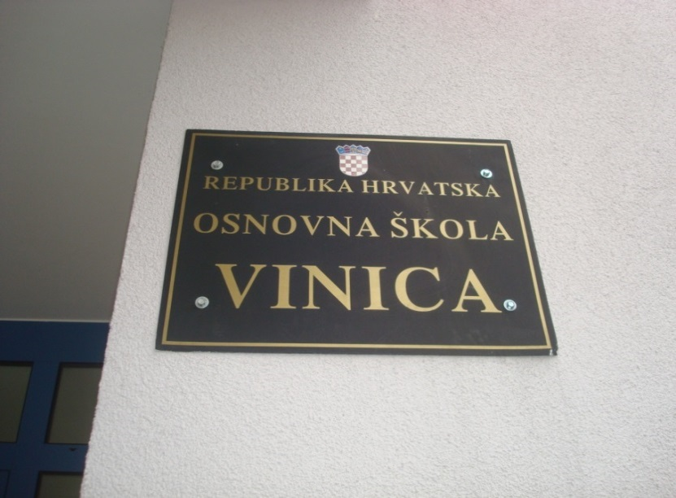
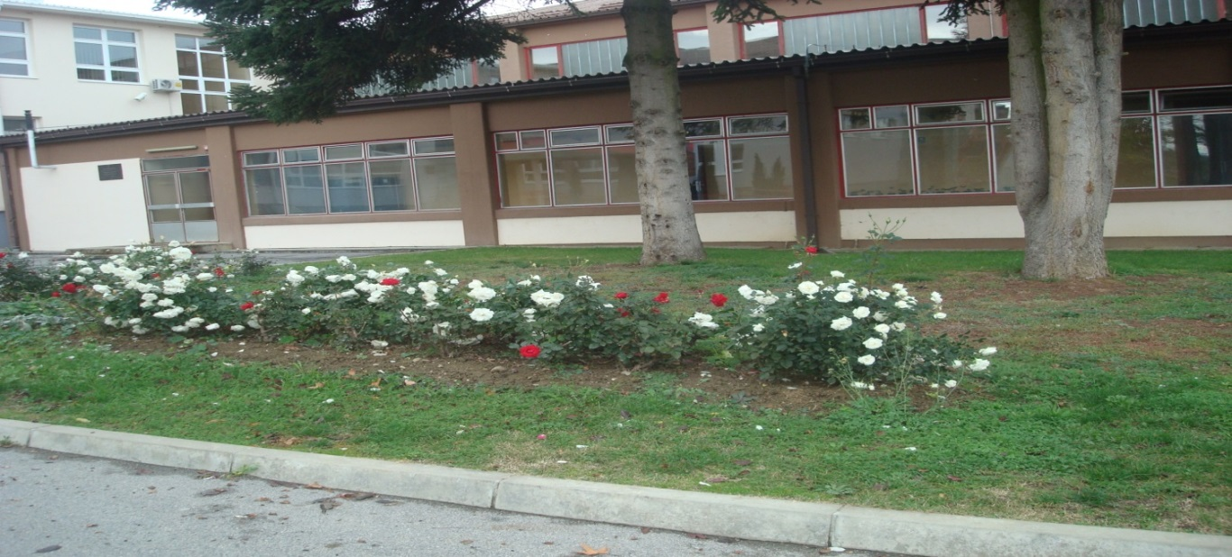
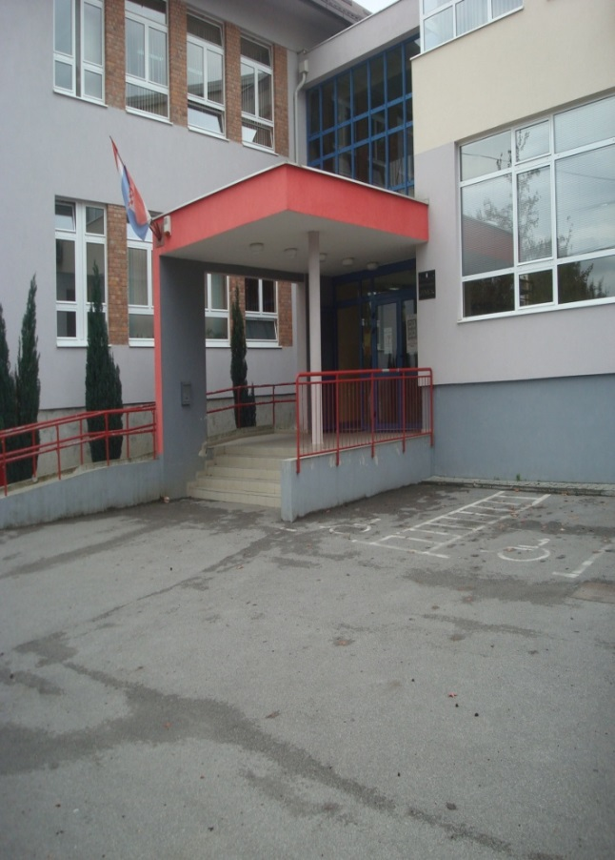
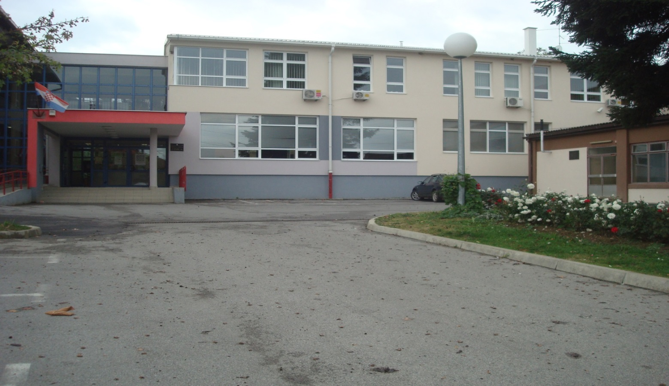
PHOTOS

Slide 4
ABOUT SCHOOL
NUMBERS OF PUPILS: 275
CLASS SECTIONS: 18
MAIN SCHOOL (MOTHER SCHOOL): 1
LOCAL SCHOOLS: 2
LOWER GRADES TEACHERS: 10
UPPER GRADES TEACHERS: 21
PEDAGOGUE: 1
SECRETARY: 1
ACCOUNTANT: 1
HEADMASTER: 1
OTHER PERSONNEL: around 10

Slide 5
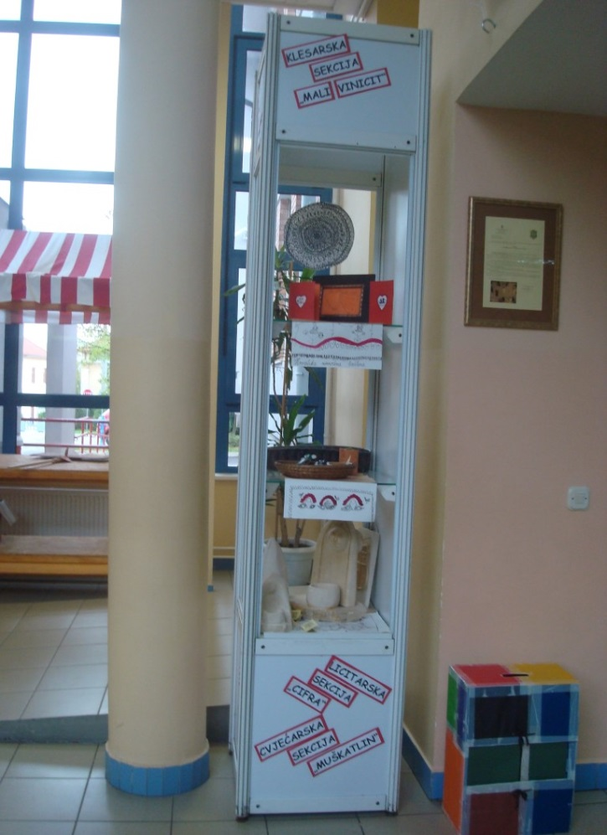
SCHOOL’S HALL

Slide 6
OUR SCHOOL LIBRARY
School libary has about 2200 books – 1000 for teachers – 10 magazines and 200 multimedia units.
There’s enough place for 25 pupils that can learn there.
made by: Antonija

