Slide 1
Domagoj Galeković Aleksandar Malić Andreja Ivačić Nataly fojs Lorena Šestanj

Slide 2
Capital city of Croatia
Population
Flag of Croatia
School
Vinica

Slide 3
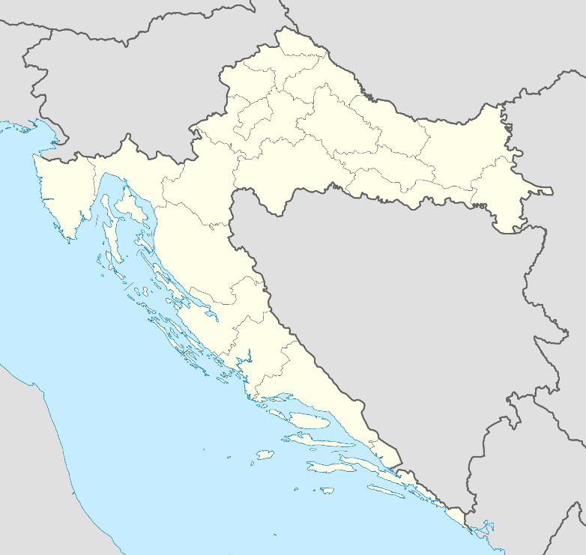
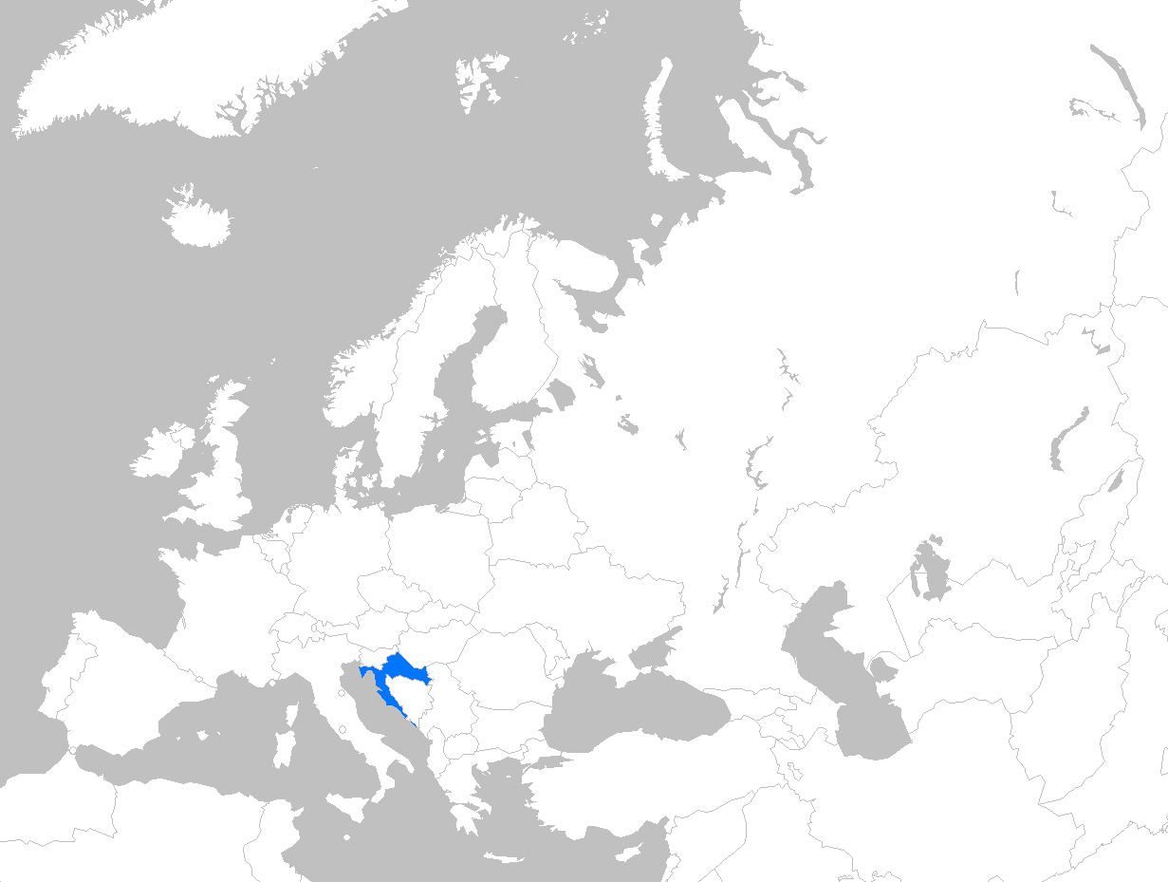
WHERE DO WE COME FROM
Vinica
Croatia

Slide 4
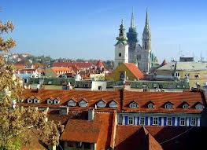
Capital city of Croatia
Capital city of Croatia is Zagreb.
Zagreb is the biggest city in Croatia.
It has got many streets, schools, buildings and people.
There are many landmarks and statues.
Zagreb is in the north-west of Croatia. On the river Sava.

Slide 5
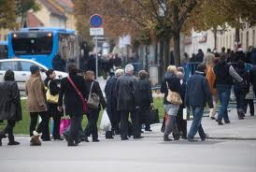
Population
Croatia has got 4,284,889 people.
Population is falling down.
In Zagreb there lives almost 1 milion people.

Slide 6
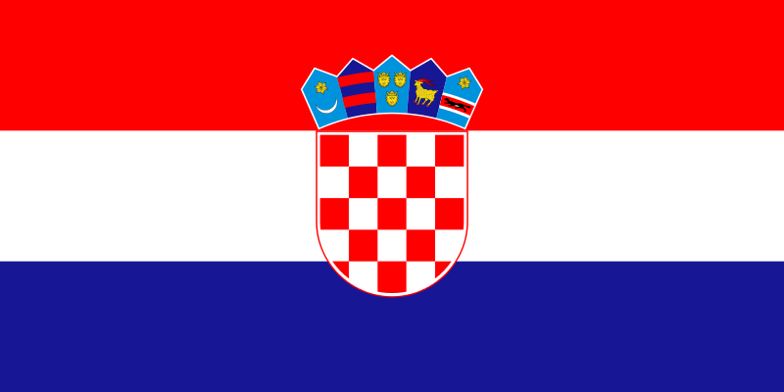
Flag of Croatia
Flag of Croatia has got three colours: red, white and blue.
In the middle of flag is coat of arms.

Slide 7
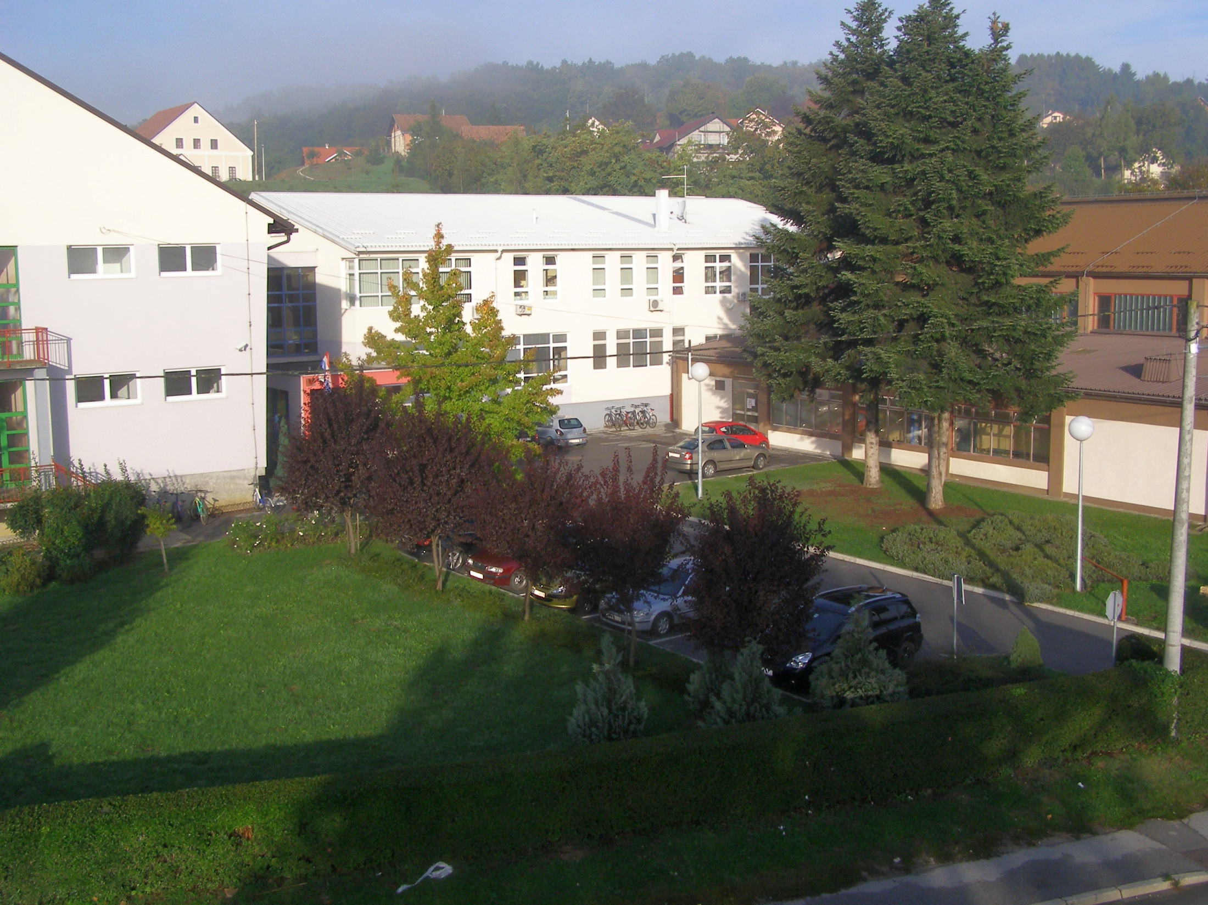
School
Our school is called Primary school Vinica.
This school is in the small place Vinica.
There are 275 students in school.

Slide 8
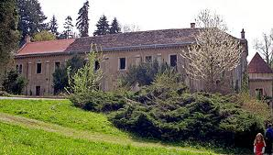
Vinica
Vinica is a small place in Croatia.
Vinica is in the north-west of Croatia.
In Vinica there live 3.389 people.
There is a nice park – Opeka (means brick).
The nearest town to us is Varaždin.

