Slide 1
Bullying isn’t cool

Slide 2
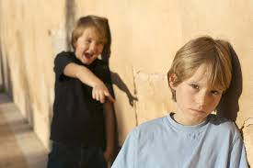
“Never do a wrong thing to make a friend--or to keep one.”

Slide 3
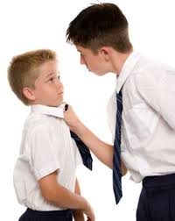
“If they don't like you for being yourself, be yourself even more.”

Slide 4
If you're horrible to me, I'm going to write a song about it, and you won't like it. That's how I operate

Slide 5
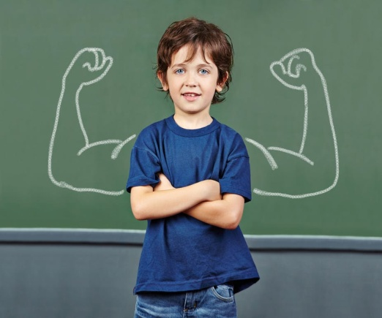
“Be yourself. Don't worry about what other people are thinking of you, because they're probably feeling the same kind of scared, horrible feelings that everyone does.”

Slide 6
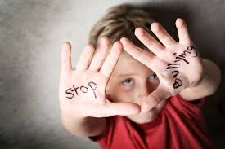
People who repeatedly attack your confidence and self-esteem are quite aware of your potential, even if you are not.”

Slide 7
“Every time you post something online, you have a choice.

Slide 9
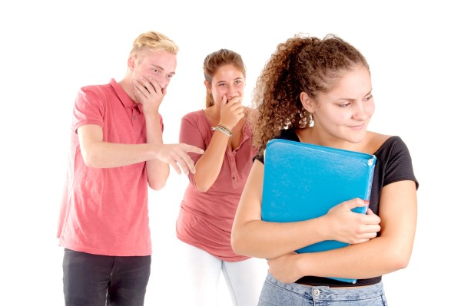
You can either make it something that adds to the happiness levels in the world—or you can make it something that takes away.

Slide 10
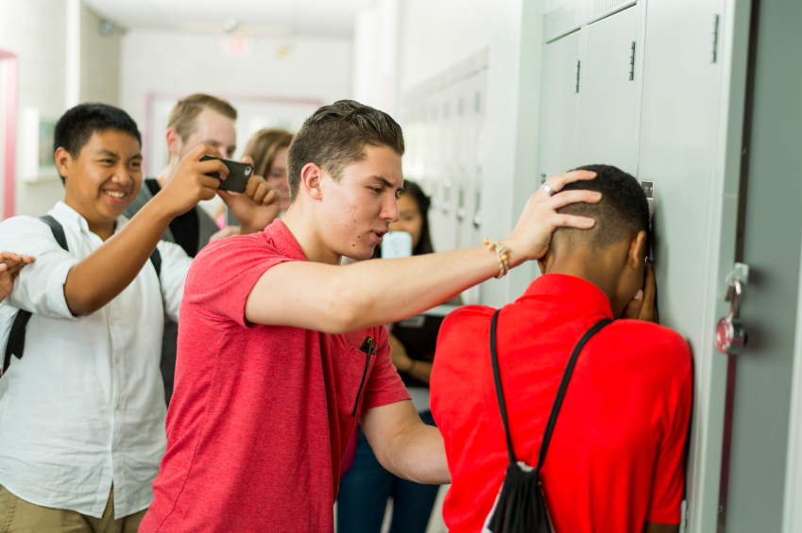

Slide 11
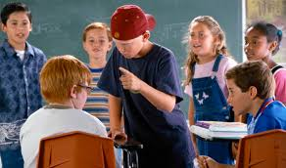

Slide 12
You can never reach the sky by humiliating others.

